Slide 1
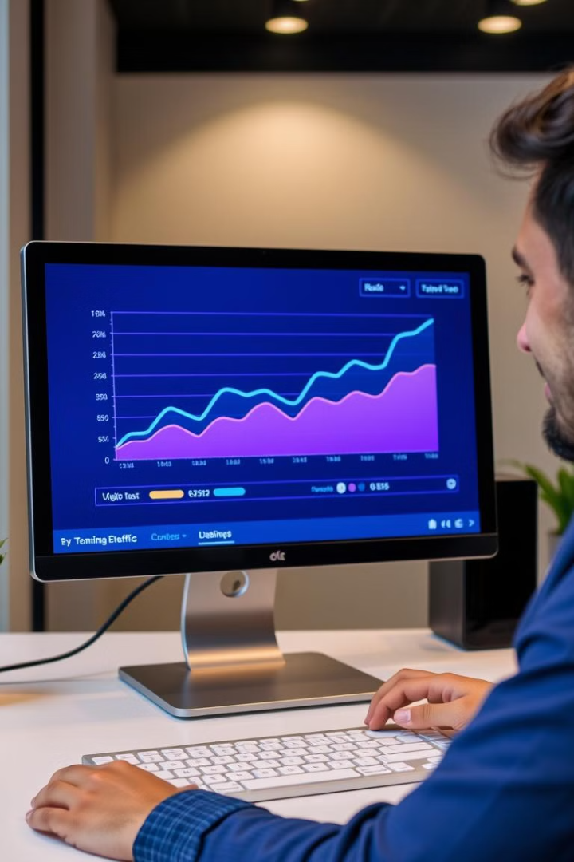
COMPREHENSIVE SEO AUDIT & OPTIMIZATION FOR ORGANIC TRAFFIC GROWTH
GAYATHRI V - MBE11 - GUVI

Slide 2

DESKERA - COMPANY SELECTION
COMPANY URL
Deskera, founded in 2008, has quickly become a leading global SaaS provider dedicated to advancing businesses.
Understanding that small and medium enterprises are vital to the economy, Deskera is committed to helping them grow and exceed expectations.
- Our all-in-one, cloud-based ERP software streamlines business operations for maximum efficiency, accessible on any device.
With our ERP and MRP solutions, businesses gain unparalleled data access, empowering them to make informed decisions that drive success.

Slide 3

TASK - I
INITIAL AUDIT

Slide 4




INITIAL AUDIT - ADVANTAGE
BASIC SEO
ADVANCED SEO
PERFORMANCE
SECURITY
- The meta description is set and is 79 characters long.
- The page is using the canonical link tag.
-All JavaScript files appear to be minified.
- Directory Listing seems to be disabled on the server.
- One or more keywords were found in the title and description of the page.
- The page does not contain any no index header or meta tag.
- All CSS files appear to be minified.
- Google has not flagged this site for malware.
- The response time is under 0.2 seconds.
- Both the www and non-www versions of the URL are redirected to the same site.
- The site is using a secure transfer protocol (https).
- One H1 tag was found on the page.
- H2 tags were found on the page.
- The site has a robots.txt file.
- The page has a correct number of internal and external links.
- All the required Open Graph meta tags have been found.

Slide 5

INITIAL AUDIT - LIMITATION
BASIC SEO
ADVANCED SEO
The SEO title is 79 characters long, which is too long.
No Schema.org data was found on your page.
Some images on the page have no alt attribute. (105)
PERFORMANCE
The server is not using "expires" headers for the images.
The page makes 127 requests. More than 20 requests can result in slow page loading.
The size of the HTML document is 82 Kb. This is over our recommendation of 50 Kb.

Slide 6

TASK - II
KEYWORD RESEARCH

Slide 7
KEYWORD RESEARCH DATA
PRIMARY KEYWORDS
Volume
Competition
Difficulty
Deskera
10,000 - 50,000
High
High
Business Management Software
5,000 - 20,000
Medium
Medium
ERP Software
15,000 - 60,000
High
High
Cloud Accounting
8,000 - 30,000
Medium
Medium
Financial Management
10,000 - 40,000
Medium
Medium
SECONDARY KEYWORDS
Deskera India
1,000 - 5,000
Low
Low
Cloud-Based ERP
5,000 - 20,000
Medium
Medium
Financial Software Solutions
3,000 - 15,000
Medium
Medium
Business Automation
4,000 - 18,000
Medium
Medium
Deskera Reviews
1,000 - 5,000
Low
Low
LONG-TAIL KEYWORDS
Best ERP software for small business in India:
500 - 2,000
Low
Low
Cloud accounting software for startups:
500 - 2,000
Low
Low
Deskera financial management features:
300 - 1,500
Low
Low
How to use Deskera for business growth:
200 - 1,000
Low
Low
Deskera ERP pricing and plans:
300 - 1,500
Low
Low

Slide 8





COMPETITORS AND THEIR KEYWORDS
NetSuite:
Odoo ERP:
Zoho Books:
Keywords: ERP customization options, ERP modules for specific industries, Odoo CRM integration
Keywords: Cloud ERP for large enterprises, NetSuite customization services, NetSuite financial reporting tools
Keywords: Accounting software for startups, Zoho Books invoicing features, Zoho Books tax management
Content Strategy: Focuses on comprehensive solutions, highlighting the integration of various modules, and providing detailed case studies and success stories.
Content Strategy: Emphasizes scalability and customization, with content that showcases client success stories, detailed product guides, and whitepapers.
Content Strategy: Targets small to medium-sized businesses with user-friendly content, tutorials, and blog posts that address common accounting challenges.
Sage Intacct:
Acumatica:
Keywords: Advanced financial management software, Sage Intacct budgeting tools, Sage Intacct multi-entity accounting
Keywords: Flexible ERP solutions, Acumatica CRM integration, Acumatica inventory management
Content Strategy: Highlights flexibility and scalability, with a strong focus on customer testimonials, industry-specific use cases, and educational content.
Content Strategy: Focuses on advanced financial management features, with content that includes in-depth guides, webinars, and case studies.

Slide 9

TASK - III
ONPAGE SEO

Slide 10
HOME PAGE- ON PAGE SEO
HOME PAGE URL
Title Tag
Meta Description
Keywords in Content & Headings
Current: "Deskera - All-in-One Business Management Software“
Suggestion: Incorporate keywords like "ERP for SMEs" and "cloud ERP solutions" to improve relevance.
Current: "Deskera is a cloud-based business management software that helps small businesses with accounting, payroll, CRM, and more."
Suggestion: Focus on "cloud ERP solutions" for better keyword alignment.
Current: "cloud ERP," "accounting software“
Suggestion: Use more industry-specific terms in headings for better SEO.
Internal/External Linking
Image Alt Texts
Current: Strong internal linking.
Suggestion: Add external links to industry authority sites to improve credibility.
Current: Simple alt texts.
Suggestion: More descriptive, keyword-rich alt tags would improve SEO.

Slide 11
OVERVIEW PAGE- ON PAGE SEO
OVERVIEW PAGE URL
Title Tag
Meta Description
Keywords in Content & Headings
Current: "About Deskera - Our Story, Mission, and Vision“
Suggestion: Enhance with relevant keywords like "Cloud ERP Leader."
Current: "Learn more about Deskera's journey, our mission to empower small businesses, and our vision for the future."
Suggestion: Focus more on product and industry keywords.
Current: Relevant content but lacks targeted keywords.
Suggestion: Optimize headings with targeted keywords for better SEO.
Internal/External Linking
Image Alt Texts
Current: Helpful internal links.
Suggestion: External linking to industry insights or studies would add credibility.
Current: Lacks descriptive keywords.
Suggestion: Optimize alt texts for better visibility.

Slide 12
ERP PRODUCT PAGE- ON PAGE SEO
ERP PRODUCT PAGE URL
Title Tag
Meta Description
Keywords in Content & Headings
Current: "Deskera ERP - Streamlined Business Management“
Suggestion: Include additional terms like "best cloud ERP for businesses" to enhance relevance.
Current: "Discover Deskera ERP, the ultimate solution for managing your business operations, from accounting to CRM and beyond.“
Suggestion: Focus on additional relevant keywords.
Current: Well-placed keywords in descriptions and headings.
Suggestion: Use more long-tail keywords for niche audiences.
Internal/External Linking
Image Alt Texts
Current: Effective internal links.
Suggestion: Add more external links to case studies or ERP comparison articles.
Current: Basic alt texts.
Suggestion: Improve with feature-specific descriptions like "ERP dashboard."

Slide 13
BLOG PAGE- ON PAGE SEO
BLOG PAGE URL
Title Tag
Meta Description
Keywords in Content & Headings
Current: "Deskera Blog - Insights and Tips for Small Businesses"
Suggestion: Add phrases like "ERP insights" or "business management tips" to increase engagement.
Current: "Stay updated with Deskera's blog for the latest insights, tips, and trends in business management and software solutions."
Suggestion: Focus on additional relevant keywords.
Current: Well-optimized for relevant keywords.
Suggestion: Include more long-tail keywords related to business management.
Internal/External Linking
Image Alt Texts
Current: Strong internal linking.
Suggestion: Add external links to relevant research or articles.
Current: Lacks keyword-rich alt texts.
Suggestion: Add detailed descriptions to improve search engine rankings.

Slide 14
SEO Recommendations
Title Tags:
Meta Descriptions:
Keyword Use:
Add long-tail keywords relevant to each page to boost rankings.
Incorporate additional relevant keywords to improve alignment with search queries.
Ensure long-tail and industry-specific keywords in headings and content.
Linking:
Image Optimization:
Strengthen external linking to industry reports, case studies, and blogs.
Improve alt texts with descriptive, keyword-rich phrases for all pages.

Slide 15

TASK - IV
TECHNICAL SEO

Slide 16










TECHNICAL SEO AUDIT - HOME PAGE
Content Displays Well on Mobile Device:
Safe Browsing (HTTPS):
Page Loading Speed:
Broken Links and Redirects:
Secure HTTPS is in place, but all scripts and external assets should be loaded over HTTPS.
Page load speed is slower due to heavy elements, so images should be optimized, lazy loading implemented, and CSS/JS minified.
No broken links were detected on the homepage, but tools like SEMrush or Screaming Frog should be used for regular monitoring.
The content adjusts well, but large images slow down mobile performance, so images and scripts should be optimized for mobile.
Duplicate Content:
Canonical URLs:
XML Sitemap:
Robots.txt File:
No duplicate content was found, but unique meta descriptions and content should be ensured.
Correct canonical URL implementation is in place, so proper canonical URLs should be maintained to prevent duplication.
The XML sitemap includes the homepage, and it should be kept updated in Google Search Console.
The file is properly configured, allowing the homepage to be crawled, so no changes are required.
Rich Snippet:
Open Graph:
No rich snippets were detected, so schema markup for rich snippets (organization, website) should be added.
Open Graph tags are present but could be optimized, so image, title, and description should be enhanced for better social sharing.
URL

Slide 17
TECHNICAL SEO AUDIT - OVERVIEW PAGE
Content Displays Well on Mobile Device:
Safe Browsing (HTTPS):
Page Loading Speed:
Broken Links and Redirects:
HTTPS is active and properly implemented; ensure all content loads securely.
Slight delays in mobile loading detected; compress scripts and remove unused code to enhance speed.
No broken links detected; regularly check for link errors using SEMrush or other tools.
Mobile layout is responsive, but large images slow performance; compress images for faster mobile loading.
Duplicate Content:
Canonical URLs:
XML Sitemap:
Robots.txt File:
No duplicate content found; continue to keep meta descriptions and content unique.
Canonical URLs are implemented; ensure continued consistency in their usage.
The sitemap is functioning correctly; no changes necessary.
The overview page is crawlable; no changes required.
Rich Snippet:
Open Graph:
No rich snippets implemented; add structured data to qualify for rich snippets.
Open Graph tags are present but could be optimized, so image, title, and description should be enhanced for better social sharing.
URL

Slide 18
TECHNICAL SEO AUDIT - PRODUCT PAGE
Content Displays Well on Mobile Device:
Safe Browsing (HTTPS):
Page Loading Speed:
Broken Links and Redirects:
HTTPS is active, but all external scripts should be secured via HTTPS.
Page load speed is slowed by images and media, so lazy loading and JavaScript deferral should be implemented.
No broken links were detected, but regular checks for new redirects or missing pages are recommended.
The layout adjusts well, but heavy elements affect performance, so product images and videos should be optimized for mobile.
Duplicate Content:
Canonical URLs:
XML Sitemap:
Robots.txt File:
No duplicate content was found, but product descriptions should remain unique
Canonical URLs are properly implemented, and their usage should be maintained to prevent duplication.
XML Sitemap: Product pages are included in the sitemap, and it should be regularly updated.
The robots.txt file is correctly configured and requires no changes.
Rich Snippet:
Open Graph:
No product-rich snippets were detected, so implementing structured data for product details like pricing and reviews is recommended.
OG tags are present but not fully optimized, so product-specific OG tags should be added for better social media sharing.
URL

Slide 19
TECHNICAL SEO AUDIT - BLOG PAGE
Content Displays Well on Mobile Device:
Safe Browsing (HTTPS):
Page Loading Speed:
Broken Links and Redirects:
HTTPS is in place, and all scripts should continue being loaded over secure channels.
Page loading speed could be impacted by heavy blog articles with images, so lazy loading for images should be implemented.
No broken links were found, but regular scans for broken internal and external links are recommended.
Blog content is responsive, but large images and videos may slow downloading, so these elements should be optimized for mobile.
Duplicate Content:
Canonical URLs:
XML Sitemap:
Robots.txt File:
No duplicate content was found, but meta descriptions should remain unique for each article.
Canonical URLs are properly implemented, and their use should continue, especially for blog posts with duplicate or syndicated content.
Blog pages are included in the XML sitemap, which should be regularly updated when adding new blog posts.
The robots.txt file is properly configured to allow crawling, and no changes are required.
Rich Snippet:
Open Graph:
No rich snippets were detected, so implementing schema markup for rich snippets, such as FAQs, reviews, or article summaries, is recommended.
Open Graph tags are present but not optimized, so optimizing them with the most engaging title, image, and description for social media sharing is recommended.
URL

Slide 20
Recommended Improvements
Home Page
Overview Page
Product - ERP Page
Blog Page
Issues: - No caching implemented, slow page load speed, heavy images. - Lack of structured data and minimal Open Graph optimization.
Recommendations: - Implement caching, compress images, add structured data, and optimize Open Graph tags.
Issues: - Mobile performance impacted by large images. - Lack of structured data for rich snippets.
Recommendations: - Optimize for mobile, compress images, add structured data (FAQ, Breadcrumb).
Issues: - Slow page load due to heavy media. - No structured data for product schema or rich snippets.
Recommendations: - Implement lazy loading, optimize images, and add structured data for product details.
Issues: - Slow page load due to image-heavy content. - No structured data or rich snippets.
Recommendations: - Optimize images, add Article schema for structured data, and include Open Graph optimization.

Slide 21
BEST PRACTICES TO IMPROVE SITE SPEED:
Image Optimization:
Minifying CSS & JavaScript:
Leverage Browser Caching:
- Compress images using formats like WebP or tools such as TinyPNG to reduce file size without losing quality.
- Minify CSS and JavaScript files using tools like CSSNano or UglifyJS to remove unnecessary code and improve load times.
- Use cache-control headers to store static resources (e.g., CSS, JS, images) on users' browsers for faster repeat visits.
Enable Gzip Compression:
Lazy Loading:
- Enable Gzip compression to reduce the size of the HTML, CSS, and JavaScript files before sending them to the browser.
- Implement lazy loading for images and videos so they load only when they come into the viewport, reducing initial page load times.

Slide 22

TASK - V
CONTENT STRATEGY
VS

Slide 23
CONTENT STRATEGY - BEST PRACTICES:
1
Content Personalization
2
Leverage User-Generated Content
3
Optimize for Mobile
Use insights from user behavior and segmentation to deliver relevant content to different audiences.
Ensure all content (blogs, videos, infographics) is mobile-responsive.
Share user reviews, testimonials, or success stories on your website and social channels.
4
Consistency
5
Repurpose Content
Publish content consistently to keep your audience engaged.
Convert blog posts into infographics, videos, or social media snippets to reach different audiences.

Slide 24
CONTENT STRATEGY PLAN

Slide 25
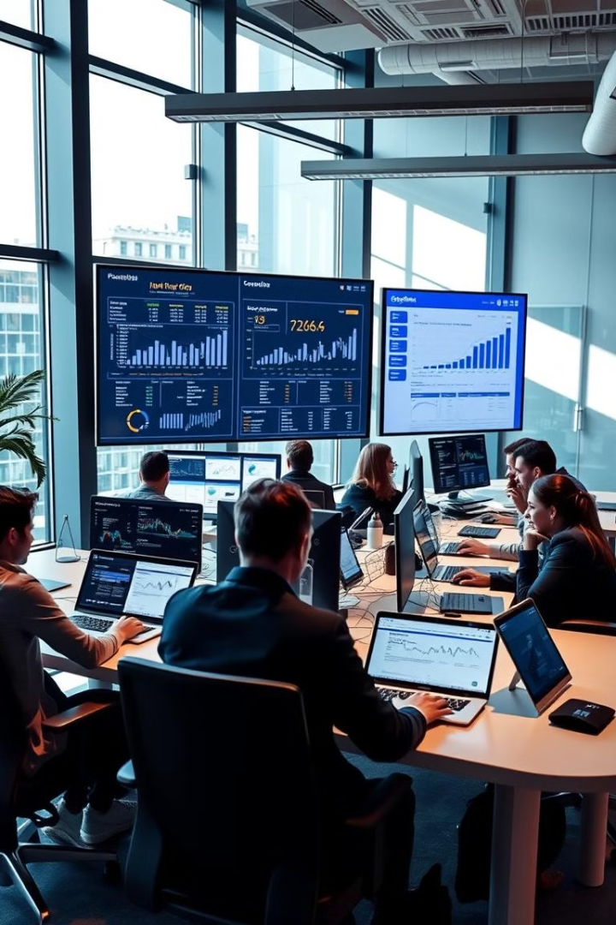
TASK VI
OFF-PAGE SEO

Slide 26





Link-Building Strategies
Guest Blogging
Partner with authoritative websites in the business software niche for guest posts to drive traffic and earn backlinks. Focus on 5-10 blogs per month.15
Resource Link Building
Create high-quality, resource-rich content (e.g., whitepapers, guides) that other websites will want to link to.
Broken Link Building
Identify broken links on reputable sites using tools like Ahrefs or SEMrush and offer your content as a replacement.
Competitor Backlink Analysis
Regularly audit competitor backlinks to identify link-building opportunities and replicate their strategies.
Directory Submissions
Submit Deskera to reputable business directories like Clutch, G2 Crowd, and local directories quarterly.

Slide 27
Influencer Partnerships and Affiliate Marketing
Influencer Partnership
Establish relationships with niche influencers to collaborate on product reviews, mentions, and promotions.
Affiliate Marketing
Launch an affiliate marketing program to incentivize partners to promote Deskera’s products in exchange for commissions.

Slide 28
Social Media Engagement
Influencer Partnership
Establish relationships with niche influencers to collaborate on product reviews, mentions, and promotions.
Influencer Partnerships
Collaborate with industry influencers who can amplify Deskera’s message by sharing content and providing product mentions.
Community Engagement
Actively participate in forums (e.g., Quora, Reddit) and LinkedIn groups by answering questions and sharing insights.

Slide 29
Online Reputation Management
Review Monitoring
Regularly share content across platforms like LinkedIn, Facebook, and Twitter. Engage with audiences using polls, Q&A sessions, and live demos.
Brand Mentions
Track and engage with brand mentions using tools like Google Alerts. Ensure that mentions include backlinks where appropriate.
Press Releases
Share newsworthy company updates through media outlets to build authority and backlinks.

Slide 30
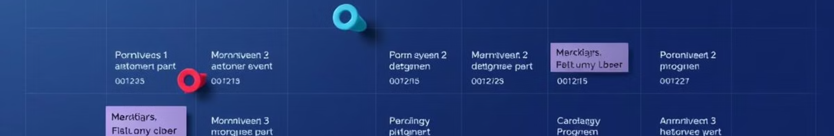
Strategy Action Timeline
Guest Blogging
Outreach to authoritative blogs
Ongoing, 5-10 blogs/month
Competitor Backlink Analysis
Identify and replicate competitor backlinks
Quarterly
Social Media Engagement
Post 3-4 times/week on all platforms
Weekly
Review Monitoring
Monitor and respond to user reviews
Weekly
Directory Submissions
Submit to relevant industry directories
Quarterly
Influencer Partnerships
Identify and partner with influencers
Quarterly
Press Releases
Publish after major updates
Quarterly or as needed

Slide 31
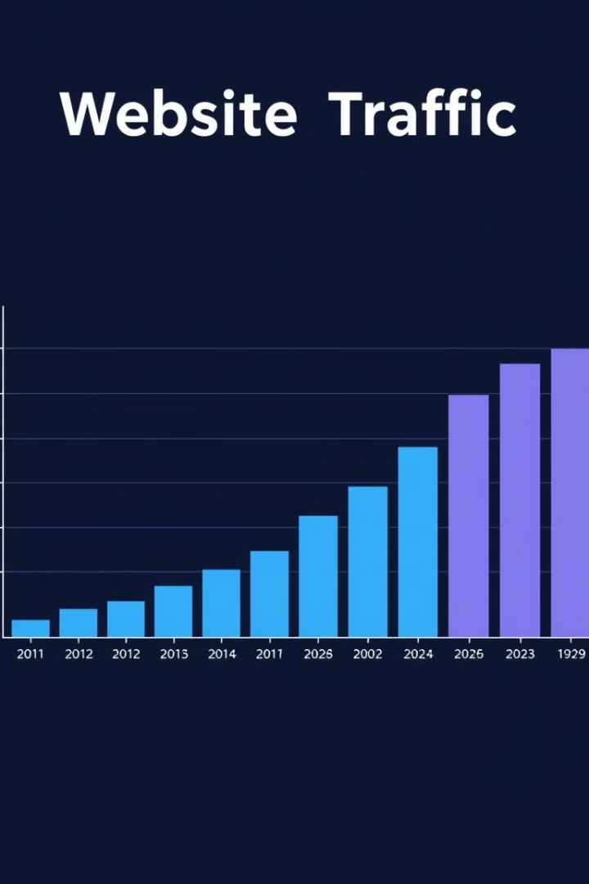
SEO PROJECT OUTCOME

Slide 32
SEO PROJECT OUTCOME
Keyword Research
On-Page SEO
Off-Page SEO
Strategic focus on high-volume and relevant keywords like "ERP software" and "cloud accounting" led to more targeted content, attracting qualified organic traffic.
Optimized meta tags, headings, and internal linking structure improved page relevance and user experience, enhancing search engine rankings.
Efforts such as guest blogging and backlink building boosted the website's domain authority and online reputation.
Technical SEO
Content Strategy
Site speed improvements, mobile optimization, and resolving crawl errors ensured smooth site functionality and better indexing by search engines.
Engaging blog posts, infographics, and videos tailored to user needs fostered user engagement, contributing to higher rankings and traffic growth.

Slide 33

CONCLUSION

Slide 34
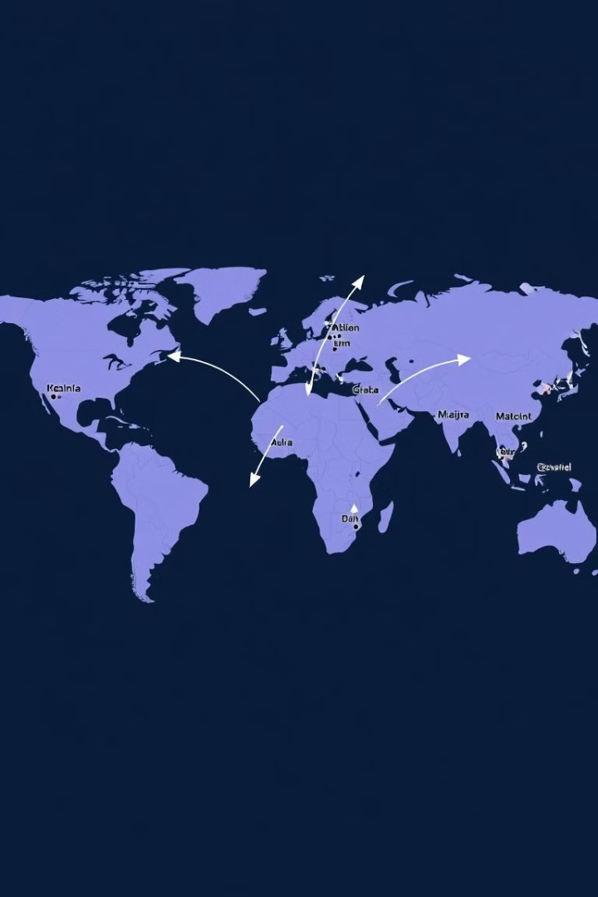
CONCLUSION
The Deskera SEO project has led to improved search rankings, higher domain authority, and better user engagement through comprehensive keyword targeting, on-page and off-page SEO, technical fixes, and strategic content creation. Deskera will be positioned to attract more qualified leads and drive long-term growth in the competitive business software market.

Slide 35

THANK YOU

